Slide 1
Logistic Regression Classifier
Deepayan Chakrabarti (deepay@utexas.edu)

Slide 2
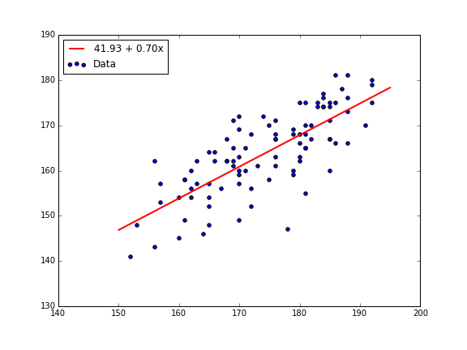
Logistic Regression
We have already seen linear regression
E.g., wife’s height as a linear function of husband’s height
Wife’s height
Husband’s height

Slide 3
Logistic Regression
Why not just use it for classification as well?
X = features (just as in usual regression)
Y = 0 or 1 (instead of a real number)
Not malignant
Transition zone
Malignant
1
Malignant? (y)
0
Tumor Size (X)

Slide 4
Logistic Regression
Why not just use it for classification as well?
Given a test point
Find the corresponding y value from the regression line
If y > 0.5, predict positive class, else negative class
1
Malignant? (y)
Linear regression line
0.5
0
Tumor Size (X)

Slide 5
Logistic Regression
Why not just use it for classification as well?
Given a test point
Find the corresponding y value from the regression line
If y > 0.5, predict positive class, else negative class
1
Malignant? (y)
0.5
Linear regression line
0
Tumor Size (X)

Slide 6
Logistic Regression
Why not just use it for classification as well?
The pattern is clear
Bigger tumor size ➔ more likely to be malignant
But addition of a few “uninformative” points completely unhinged the prediction
1
Malignant? (y)
0.5
Linear regression line
0
Tumor Size (X)

Slide 7
Logistic Regression
The idea behind logistic regression
Must figure out the threshold
But what if there are multiple features?
Tumor size, Tumor growth rate, Patient’s age…
1
Malignant? (y)
0.5
0
Tumor Size (X)

Slide 8
Logistic Regression
The idea behind logistic regression
Must figure out the threshold
and the feature parameters β₁, β₂, and β₃
But what if there are multiple features?
Tumor size, Tumor growth rate, Patient’s age…
1
Malignant? (y)
0.5
0
β₁*Tumor Size + β₂*Tumor Growth Rate + β₃*Patient’s Age

Slide 9
Logistic Regression
What does β₁*Tumor Size + β₂*Tumor Growth Rate versus threshold mean?
Malignant
4
1*Tumor size + 1*Tumor growth rate > 3
3
Tumor growth rate
2
1
Benign
1
2
3
4
1*Tumor size + 1*Tumor growth rate < 3
Tumor size
1*Tumor size + 1*Tumor growth rate = 3

Slide 10
Logistic Regression
The idea behind logistic regression
Must figure out the threshold
and the feature parameters β₁, β₂, and β₃
β₁ x₁ + β₂ x₂ + β₃ x₃ < threshold
Predict negative class
β₁ x₁ + β₂ x₂ + β₃ x₃ >= threshold
Predict positive class
β₀ + β₁ x₁ + β₂ x₂ + β₃ x₃ < 0
Predict negative class
β₀ + β₁ x₁ + β₂ x₂ + β₃ x₃ >= 0
Predict positive class
equivalent

Slide 11
Why call it “regression?”
Linear Regression
Logistic Regression
score = β₀ + β₁ x₁ + β₂ x₂ + β₃ x₃
The score is our prediction of y
y is a real number
score = β₀ + β₁ x₁ + β₂ x₂ + β₃ x₃
Negative score ➔ negative class Positive score ➔ positive class
y is a class label (0 or 1)

Slide 12
Logistic Regression
The idea behind logistic regression
Must figure out the threshold (-β₀)
and the feature parameters β₁, β₂, and β₃
Dealing with the threshold in such circumstances turns out to be pretty difficult
so we approximate it
1
Malignant? (y)
0.5
0
Tumor Size (X)

Slide 13
Logistic Regression
We use a “soft threshold” function
Very close to 0 below the threshold
Very close to 1 above the threshold
Exactly 0.5 at the threshold
Easier to find the threshold this way
Threshold
1
Malignant? (y)
0.5
0
Tumor Size (X)

Slide 14
Logistic Regression
We use a “soft threshold” function
Shape is called a sigmoid (think: looks like an S)
Does this function have a special meaning?
1
Malignant? (y)
0.5
0
Tumor Size (X)

Slide 15
Logistic Regression
We use a “soft threshold” function
but what does this function mean?
Linear regression
y ≈ β₀ + β₁ x₁ + β₂ x₂ + β₃ x₃
y can be any real number
Classification
y can only be 0 or 1
Sigmoid
y is probabilistically 0 or 1
p = sigmoid (β₀ + β₁ x₁ + β₂ x₂ + β₃ x₃)

Slide 16
Logistic Regression
y is probabilistically 0 or 1
Calculate score = β₀ + β₁ x₁ + β₂ x₂ + β₃ x₃
Calculate sigmoid(score)
This is a number between 0 and 1
It gives the probability of belonging to the positive class
1
Malignant? (y)
0.5
0
score (β₀ + β₁ x₁ + β₂ x₂ + β₃ x₃)
Notes:
With hard thresholding, y=1 whenever score > threshold.

Slide 17
Logistic Regression
y is probabilistically 0 or 1
score = 0 ➔ sigmoid(score) = 0.5
Both positive and negative class are equally likely
If score increases, so does sigmoid(score)
Higher score means more chances of being in the positive class
1
Malignant? (y)
0.5
0
0
score = β₀ + β₁ x₁ + β₂ x₂ + β₃ x₃

Slide 18
Logistic Regression
How do we predict?
Given X
Calculate score = β₀ + β₁ x₁ + β₂ x₂ + β₃ x₃
Calculate sigmoid(score)
This is the probability of belonging to the positive class
If sigmoid(score) > 0.5, predict positive class
else predict negative class

Slide 19
Logistic Regression
When does it work?
You have a sense that
if some as-yet-unknown factor is high,
then the positive class is more likely
(so thresholding is a good idea)
E.g., getting users to click on ads
X = features of ads and users
y = 1 if the user clicks on the ad, and 0 if not
If the “relevance of the ad to the user” is high
users are likely to click on ads

Slide 20
Logistic Regression
When does it work?
You have a sense that
if some as-yet-unknown factor is high,
then the positive class is more likely
(so thresholding is a good idea)
Another example is document classification
X = words in the document
y = 1 if the document is about sports, and 0 if not
If the “fraction of sports-related words in the document” is high
the document is about sports

Slide 21
Logistic Regression
When does it work?
You have a sense that
if some as-yet-unknown factor is high,
then the positive class is more likely
(so thresholding is a good idea)
Logistic regression tries to find this unknown factor
as a linear combination of the features
β₁ x₁ + β₂ x₂ + β₃ x₃

Slide 22
Key points
Logistic Regression is a very common classification tool
because it is based on a simple idea
score = a weighted combination of features
If score > threshold
Positive class
else
Negative class
Logistic regression tries to find these weights and threshold

Slide 23
Summary
Logistic Regression is actually closely related to Naïve Bayes
Advantage
Can deal with correlated features better than Naïve Bayes
Disadvantage
Needs more computation
No closed-form expression for the feature weights and threshold
These have to be learnt essentially via optimization techniques

Slide 24
Acknowledgements
Slides by Jeff Storey

Slide 25
Link to Naïve Bayes
Predict class of (Sunny, Hot, Windy)
In Naïve Bayes
likelihood for positive class = (fraction of Sunny in positive class) * (fraction of Hot in positive class) * (fraction of Windy in positive class)
likelihood for negative class (fraction of Sunny in negative class) * (fraction of Hot in negative class) * (fraction of Windy in negative class)
Pick the class with the higher score = likelihood * prior

Slide 26
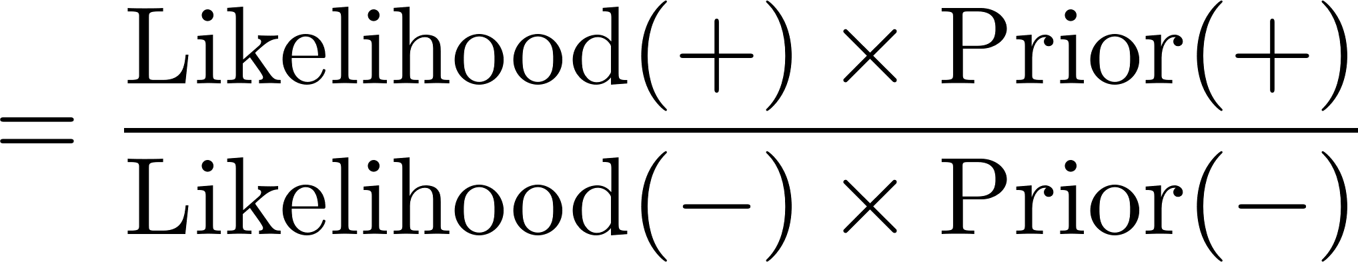
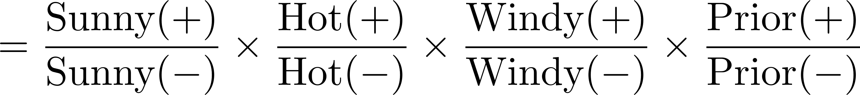
Link to Naïve Bayes
Pick the class with the higher score = likelihood * prior
Calculate the ratio of scores
Score ratio > 1 ➔ Pick the positive class
Score ratio < 1 ➔ Pick the negative class
“weight” for Sunny
“weight” for Hot
“weight” for Windy
“intercept”

Slide 27
Link to Naïve Bayes
In Naïve Bayes
Score ratio = (score for positive class) / (score for negative class) = weight for Sunny * weight for Hot * weight for Windy * intercept
In Logistic Regression
score = β₀ + β₁ x₁ + β₂ x₂ + β₃ x₃
Dummy variables for Sunny, Hot, and Windy
intercept
weight for x₁
weight for x₂
weight for x₃

Slide 28
Link to Naïve Bayes
Naïve Bayes and Logistic Regression
Similarities
There is a weight for each feature
Score = simple combination of these weights
Prediction depends on comparing score against a threshold
Differences
In Naïve Bayes, weights for each feature calculated separately
Counting how often feature appears in positive versus negative class
In Logistic Regression, all weights are calculated jointly
Harder computation
but less affected by correlated attributes

Slide 29
Logistic Regression
The idea behind logistic regression
Must figure out the threshold
but just this is not enough…
What if we have multiple features?
Tumor size
Tumor growth rate
Patient’s age
In linear regression, we looked at the weighted sum of features
y = β₀ + β₁ x₁ + β₂ x₂ + β₃ x₃
The parameters (β₀, β₁, β₂, β₃) have to be inferred
It is similar for logistic regression

Slide 30
Logistic Regression
We use a “soft threshold” function
but what does this function mean?
Earlier we had seen…
log p/(1-p) = β₀ + β₁ x₁ + β₂ x₂ + β₃ x₃
The sigmoid is just the inverse of this log-odds business
p = sigmoid (β₀ + β₁ x₁ + β₂ x₂ + β₃ x₃)

Slide 31
Link to Naïve Bayes
In Naïve Bayes
Score ratio = (score for positive class) / (score for negative class) = (fraction of Sunny in positive class) / (fraction of Sunny in negative class) * (fraction of Hot in positive class) / (fraction of Hot in negative class) * (fraction of Windy in positive class) / (fraction of Windy in negative class) * (prior for positive class) / (prior for negative class)
Score ratio > 1 ➔ Pick the positive class
Score ratio < 1 ➔ Pick the negative class
Similar in logistic regression too…

Slide 32
Link to Naïve Bayes
Score ratio = (score for positive class) / (score for negative class) = (fraction of Sunny in positive class) / (fraction of Sunny in negative class) * (fraction of Hot in positive class) / (fraction of Hot in negative class) * (fraction of Windy in positive class) / (fraction of Windy in negative class) * (prior for positive class) / (prior for negative class)
“weight” for Sunny
“weight” for Hot
“weight” for Windy
“intercept”

